Slide 1
FAITH: Why Do We Lose It?
New England Parish Life Conference
Plymouth, MA
Fr. Theodore Pulcini
Session One: 21 June 2024

Slide 2
Something is happening… The “Great Apostasy”? (cf. 2 Thesslonians 2:1-3)
Now concerning the coming of our Lord Jesus Christ and our assembling to meet him, we beg you, brethren, ² not to be quickly shaken in mind or excited, either by spirit or by word, or by letter purporting to be from us, to the effect that the day of the Lord has come. ³ Let no one deceive you in any way; for that day will not come, unless the rebellion [apostasía] comes first, and the man of lawlessness is revealed…
In just about two months’ time this past winter, the following appeared in “Microsoft Start,” a news aggregator featuring articles chosen by Microsoft Network editors:
“19 Ways to Rekindle Your Faith in God Again”
“12 Reasons Why American Christianity is RAPIDLY Falling Apart”
“15 Reasons Why Christian are Losing Faith in Their Church”

Slide 3
“15 Reasons Why Some Ex-Christians Left Their Faith”
“Faith’s Fall: 25 Grim Reasons Behind the Exodus of American Christians from Christianity”
“Losing Our Religion? We’ve Always Had the Freedom to Choose Our Own Paths”
“17 Blunt and Honest Reasons People Turn Their Backs on Religion”
“17 Reasons Why Millennials Have a Problem with Religion”
“Felt Betrayed: Reasons Why Christianity Is Experiencing a Mass Exodus”
“19 Reasons More people are Saying No to Religion and Yes to Atheism”

Slide 4
“19 Reasons Christianity Is Dying in the USA”
“17 Reasons People Feel Disconnected from Church Today”
“21 Disturbing Reasons Behind Youth Exodus from the Catholic Church”
Each of these articles expresses a distinctive viewpoint, but a set of themes recurs in them, themes which I would characterize as “FAITH-CORROSIVES” which cause a “losing of faith,” as we will see in what follows.

Slide 5
For faith to be authentic: THREE ESSENTIAL COMPONENTS
The consensus in both the Christian East and Christian West:
THE “MIND” OF FAITH (its cognitive, intellectual aspect)
NOTITIA = “KNOWING”
ASSENSUS = “ASSENTING”
THE “HEART” OF FAITH (its experiential aspect)
FIDUCIA = “TRUSTING”

Slide 6
An etymological study of the Greek word pistévo implies both of these aspects
In classical Greek, the term pistos means “trusting,” with a nuance of obedience
Apistos means “distrustful” or “untrustworthy”
Pistevo thus primarily means “to trust” and “to obey”
In early Stoic texts pistis means “trust”; in later Stoic texts it means “faithfulness.”
Related to Hebrew root ̛ M N in the LXX and NT
In the NT pistis mean both “trust” and “faith”
The aforemetioned link to the notion of obedience is evident in Hebrews 11

Slide 7
A New Interpretive Perspective
Mark 9:17-25 – a distraught man whose son is possessed but a “mute spirit”
“George” of St. Symeon the New Theologian (+1022), as described in his work “On Faith”
Divine Mercy” Icon – a new RC devotion, shrine here in Stockbridge, MA

Slide 8
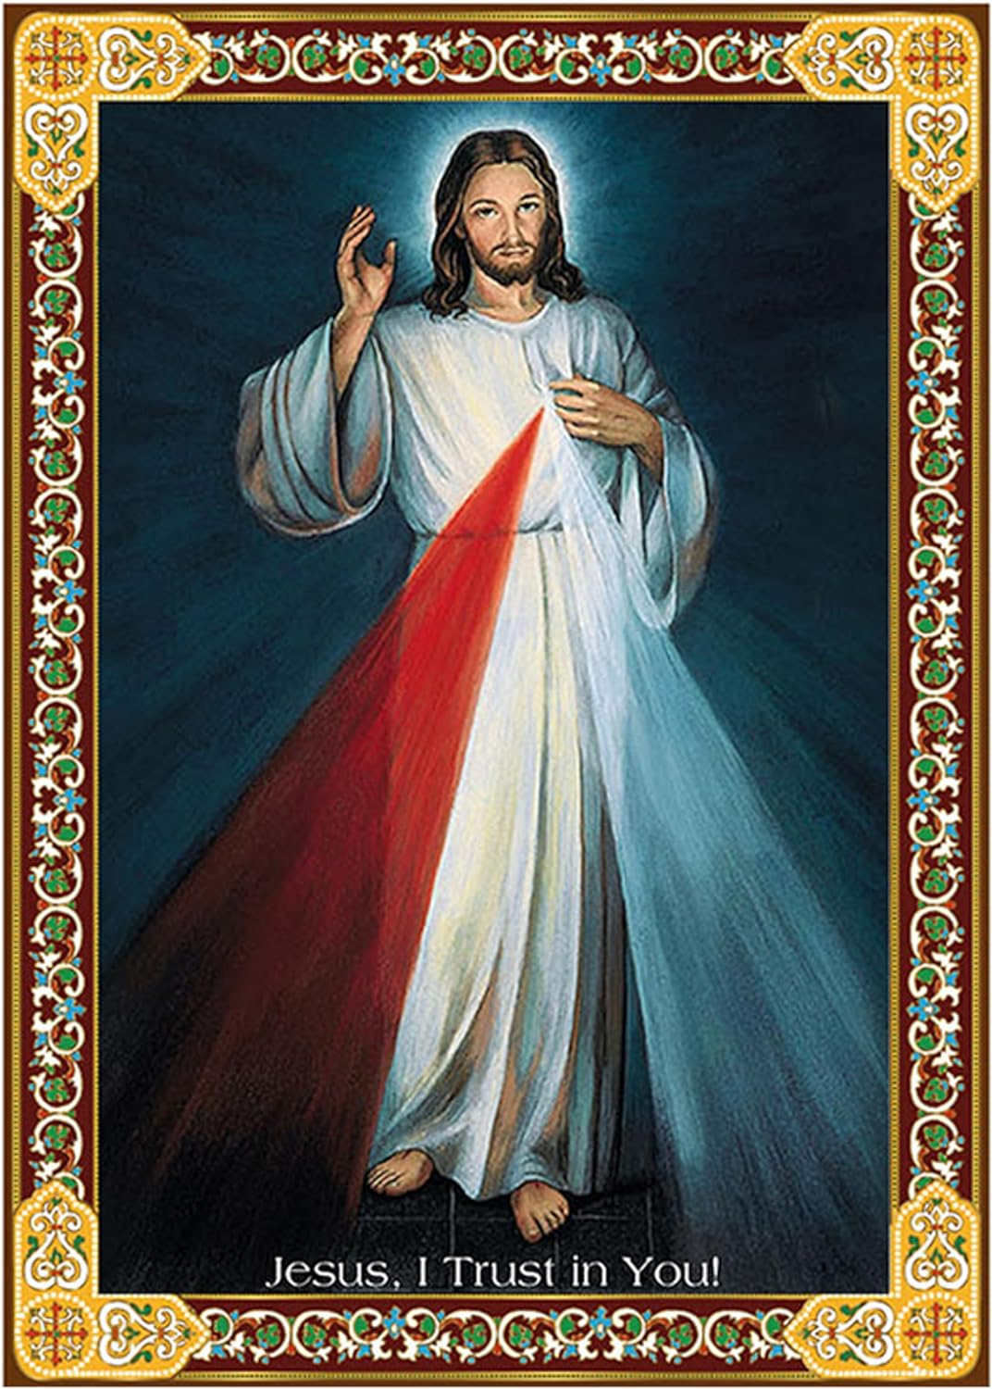

Slide 9
Hebrews 11: Faith=Obedience
Now faith is the assurance of things hoped for, the conviction of things not seen. ² For by it the men of old received divine approval. ³ By faith we understand that the world was created by the word of God, so that what is seen was made out of things which do not appear.
The Examples of Abel, Enoch, and Noah
The Faith of Abraham
⁸ By faith Abraham obeyed when he was called to go out to a place which he was to receive as an inheritance; and he went out, not knowing where he was to go…. ¹⁷ By faith Abraham, when he was tested, offered up Isaac, and he who had received the promises was ready to offer up his only son….
The Faith of Moses
²⁴ By faith Moses, when he was grown up, refused to be called the son of Pharaoh’s daughter, ²⁵ choosing rather to share ill-treatment with the people of God than to enjoy the fleeting pleasures of sin…. ²⁷ By faith he left Egypt, not being afraid of the anger of the king; for he endured as seeing him who is invisible. ²⁸ By faith he kept the Passover and sprinkled the blood, so that the Destroyer of the first-born might not touch them….
The Faith of Other Israelite Heroes
³¹ By faith Rahab the harlot did not perish with those who were disobedient, because she had given friendly welcome to the spies.
³² And what more shall I say? For time would fail me to tell of Gideon, Barak, Samson, Jephthah, of David and Samuel and the prophets….

Slide 10
THE MAIN POINT
Faith is therefore multifaceted, involving a set of interrelated components. It is not just intellectual (of “the mind”) but also relational (of “the heart”). As the glossary included in the popular edition of the Philokalia states, pistis is “not only an individual or theoretical belief in the dogmatic truths of Christianity, but an all-embracing relationship, an attitude of love and total trust in God.”
If any of its components is lacking, faith loses its “functionality”. [legal tender analogy] It becomes feeble, brittle, anemic, unstable, because the aforementioned “corrosives” of faith corrupt “the mind” and “the heart” of faith.

Slide 11
CORRODING THE “MIND” OF FAITH, ITS INTELLECTUAL COMPONENT
Autonomy vs. heteronomy (hyper-individualism vs. communal “tribal” accountability)
Political entanglement
Intellectual dissonance (competing secular worldviews, “spirituality”)
Religious globalization / urbanization
Extremism (rigidity, condemnatory exclusivism)
Materialism (health and wealth evangelism, consumerism)

Slide 12
CORRODING THE “HEART” OF FAITH, ITS EXPERIENTIAL COMPONENT
Lack of trust (scandals, hypocrisy)
Lack of transformative power (“therapeutic ethos”)
Lack of clear identity (no religious infrastructure, no obedience)
“Busyness”

Slide 13
THE IMPLICATION
All this implies that the only way to regain faith it to overcome our falsely reductionistic view of faith as a matter KNOWLEDGE and INTELLECTUAL ASSENT and to restore its other components, especially TRUST entailing obedience.
BUT HOW CAN THIS BE DONE IN A SECULAR CONTEXT WHERE TRUST IS DISINTEGRATING?

Slide 14
From the internationally recognized PEW RESEARCH CENTER
Public Trust in Government:
1958-2023
Public trust in the federal government, which has been low for decades, has returned to near record lows following a modest uptick in 2020 and 2021. Currently, fewer than two-in-ten Americans say they trust the government in Washington to do what is right “just about always” (1%) or “most of the time” (15%). This is among the lowest trust measures in nearly seven decades of polling. Last year, 20% said they trusted the government just about always or most of the time.
See: https://www.pewresearch.org/politics/2023/09/19/public-trust-in-government-1958-2023/

